Slide 2
Project Title
Shortest Path First
Dr Niharika Singh Assistant Professor,
Department of Computer Science
Aditi Singh
500076022
Sumit Kr Rana
500076729
Diya Agarwal
500077155

Slide 3
Index
Introduction
Literature Survey
Problem Statement
Objective
Application of the Project
Libraries used
Data Structure and Algorithm
Data set
Flowchart
Technical Diagrams
Pseudo Code
Test cases
Program Output
Time complexity
SWOT Analysis
References

Slide 4
Introduction
In a world where staying home is the new normal, ordering food online has become more of a habit than an occasion.
Everyone likes a fast and simple interface to order their cravings.
Now, no one likes their food to arrive cold, but most of the time this is a common lapse with every food delivery app.
This problem arises due to various factors, but a major one is taking the longer route or getting stuck in traffic.
Thus comparing multiple routes and coming up with the shortest and efficient one is invaluable.

Slide 5
Literature Survey
“Time isn’t the main thing, it’s the only thing”: Miles Davis
Taking the reference from KAPCHNAGA ROGERS WAFULA of KABARAK UNIVERSITY, Reg No. Cs/M/0095/01/11 we can defer that an online food delivery system can be the potential next revolution of the century. The system explains how we can order the food by touch of a button and get it delivered.
According to Wikipedia, Dijkstra's algorithm is an algorithm for finding the shortest paths between nodes in a graph, which here have been represented by road networks. Whereas the Travelling Salesman Problem asks the following question: "Given a list of cities and the distances between each pair of nodes, what is the shortest possible route that visits each node exactly once and returns to the origin node?“

Slide 6
Problem Statement
The problem with food service industry is that restaurants are not realizing the efficiencies that would result from better application of technology in their daily operations such as identifying an efficient and effective route for multiple deliveries along the path.

Slide 7
Objective
Analysis of the shortest path from source node to destination by comparative study of shortest path calculation algorithms and time calculation on basis of several factors like congestion, slopes, highways, road condition to generate time efficient system.

Slide 8
Application Of the Project
The area of application for this program can be on any practical food ordering website/application existing or upcoming.
Another application of the project can be for any application performing network analysis.

Slide 9
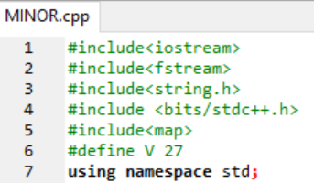
libraries used

Slide 10
Data structures and algorithms
Arrays- 1D & 2D
Maps
Vector
Dijkstra Algorithm
Travelling Salesman Problem
Time Calculator [Self-constructed]

Slide 11
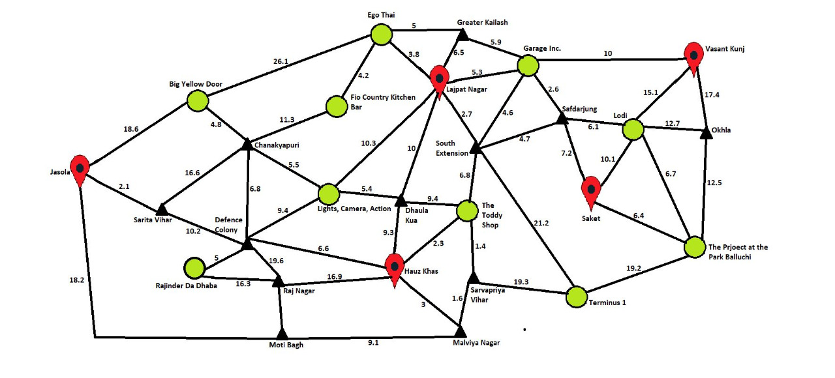
Data set

Slide 12
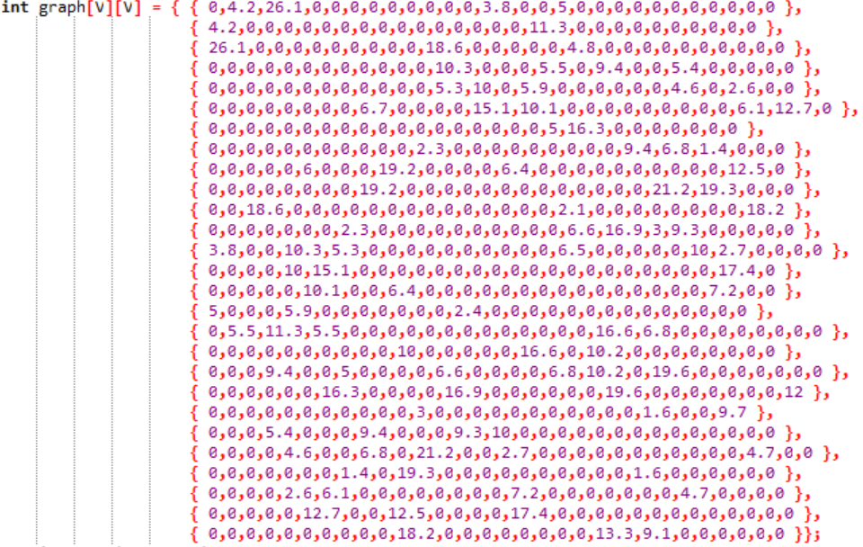

Slide 13
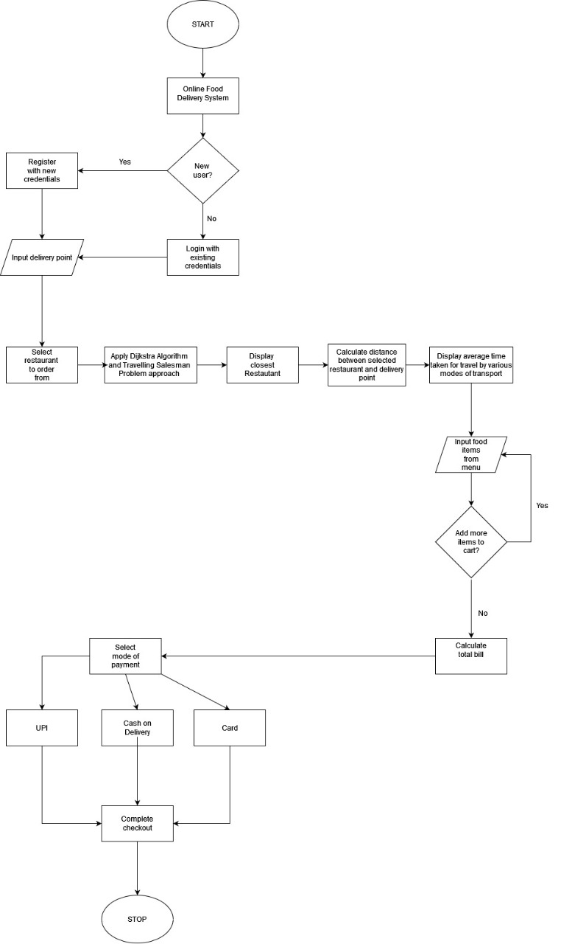
Flowchart: Program

Slide 14
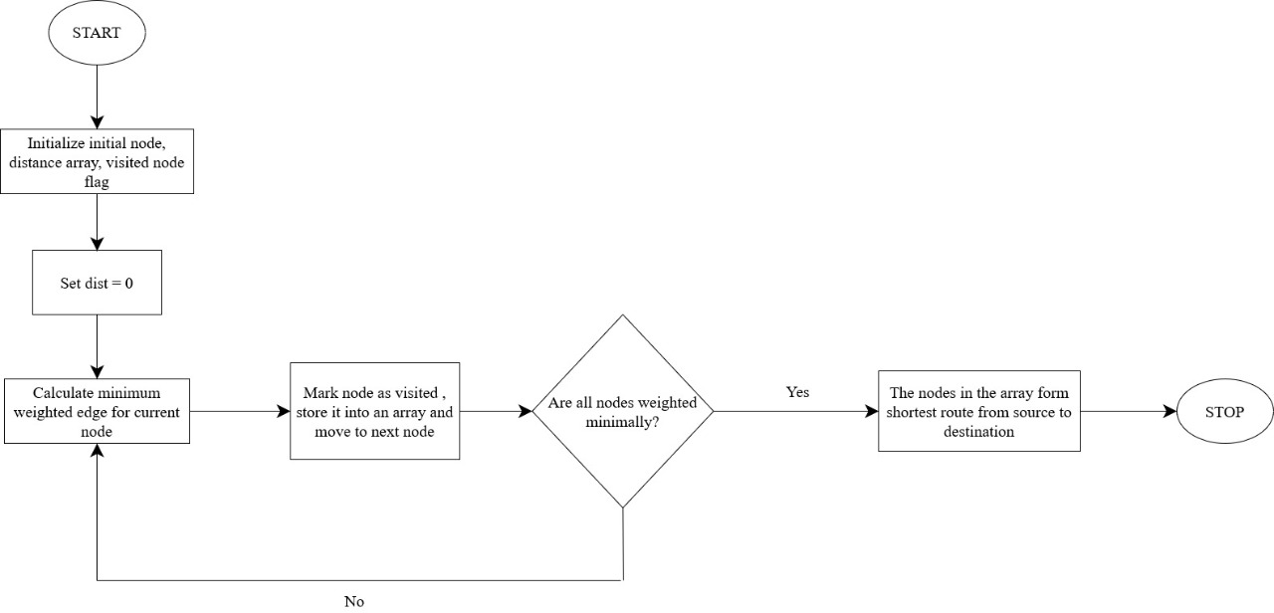
Flowchart: Dijkstra

Slide 15
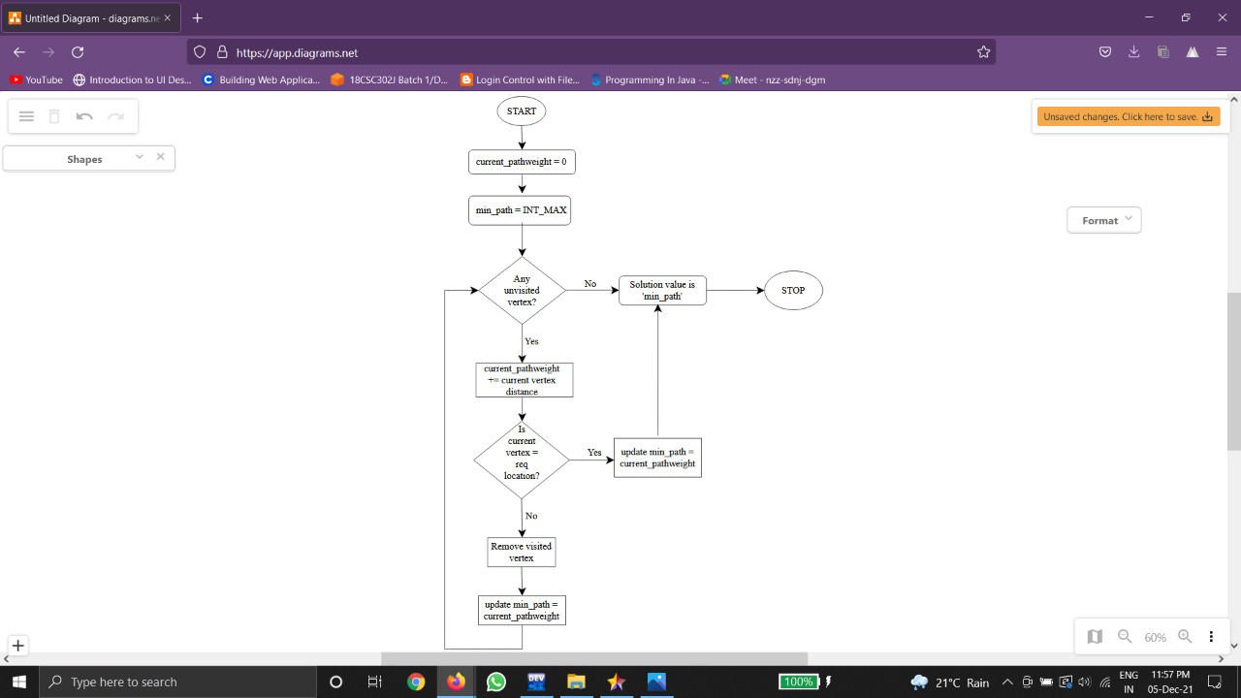
Flowchart: Traveling salesman problem

Slide 16
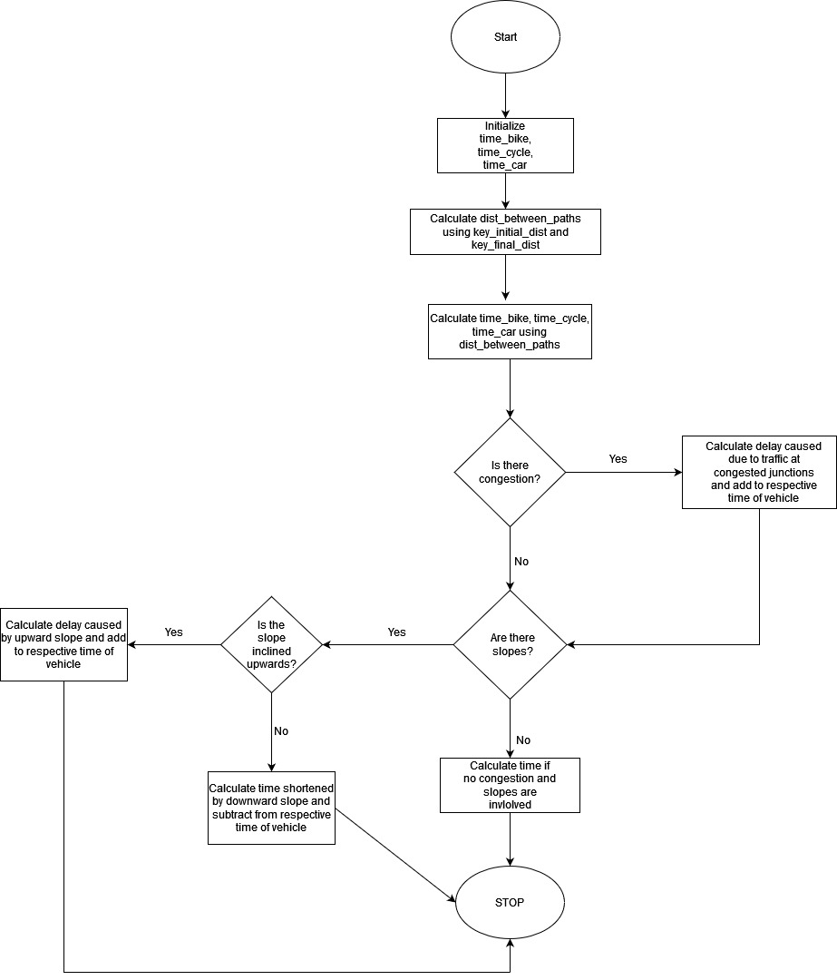
Flowchart: Time calculation

Slide 17
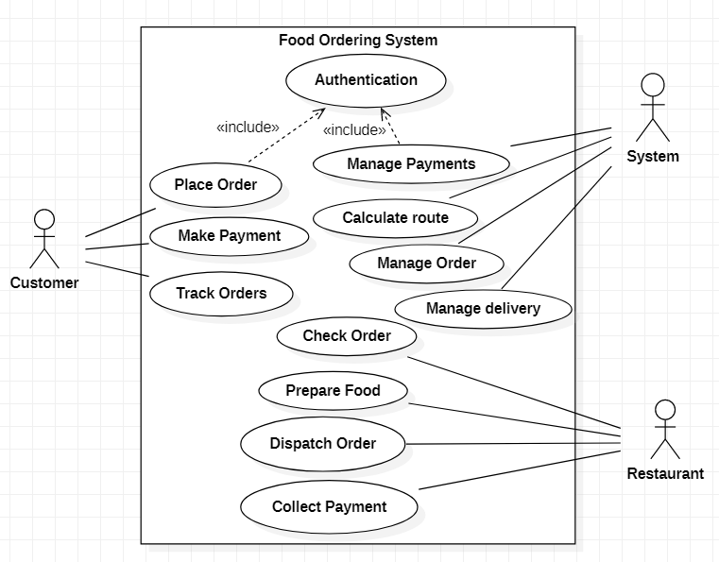
Diagrams: Use Case

Slide 18
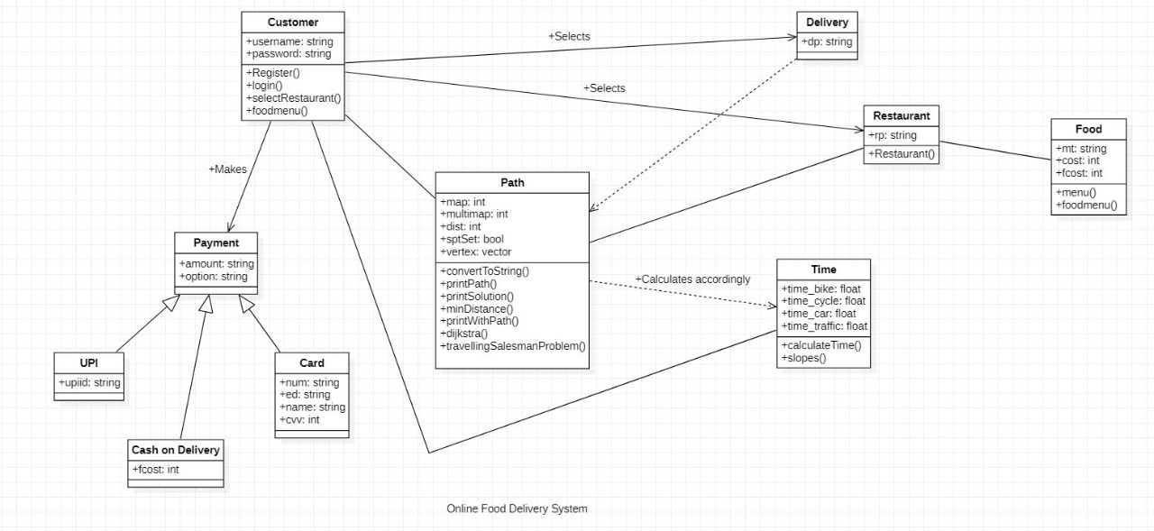
Diagrams: Class

Slide 19
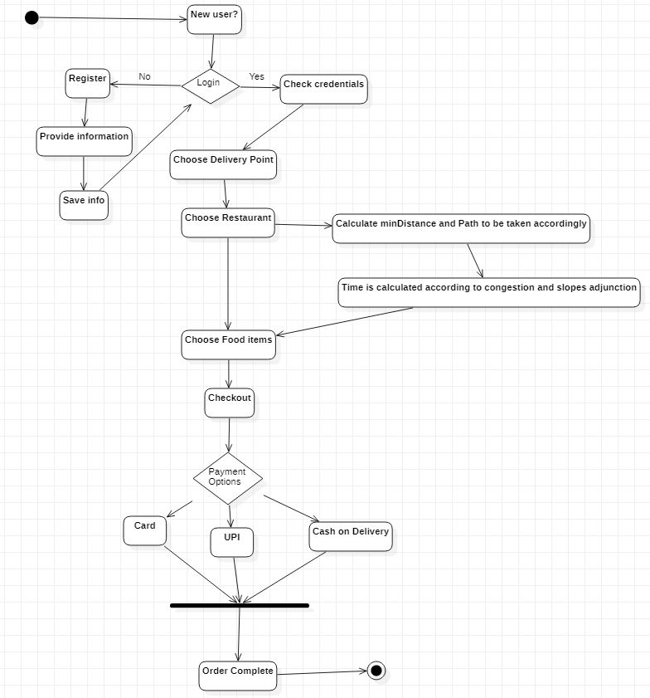
Diagrams: Activity

Slide 20
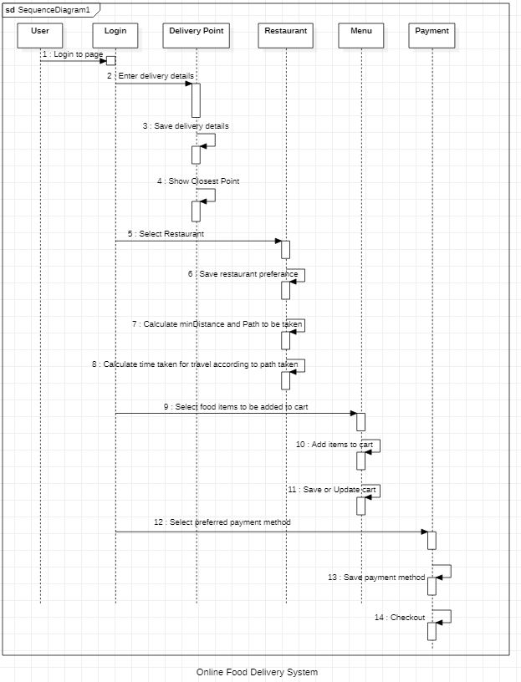
Diagrams: Sequence

Slide 21
Methodology: Pseudo code
function printWithPath(INT graph[V][V], INT src, INT dest)
initialize INT dist[V], sptSet[V], INT parent[V]
FOR each vertex in graph
1 -> parent[src]
INT_MAX -> dist[i]
FALSE -> sptSet[i]
dist[src] := 0;
FOR count = 0 to V-1
u -> calculate minDistance(dist, sptSet)
update sptSet[u] <-TRUE
FOR v = 0 to V
Check IF (!sptSet[v] && dist[u] + graph[u][v] < dist[v])
THEN
parent[v] <- u
update dist[v] := dist[u] + graph[u][v]
return parent
End function

Slide 22
Methodology: Pseudo code
function travellingSalesmanProblem(INT graph[][V], INT s, INT f)
initialize Vector<INT> vertex
FOR i=0 to V
IF (i!=s) THEN
VERTEX <- i
initialize INT count=0,Vertex <- my_travelling_path
min_path <- INT_MAX
DO
initialize current_pathweight=0 , indicator=0, k=s
FOR i=0 to vertexsize
IF ( graph[k])
THEN vertex[i]==0) and Indicator=1
Break
update current_pathweight <- current_pathweight + graph[k][vertex[i]]
vertex[i] -> k
IF k==f
BREAK
IF indicator==1
THEN
CONTINUE
CONDITION TO LIMIT LOOP:
min_path <- min(min_path, current pathweight)
BREAK
WHILE all permutations checked
return min_path
End function

Slide 23
Methodology: Pseudo code
function calculateTime()
initialize time_bike=0, time_cycle=0, time_car=0
Dist <- graph[key_initial][key_final]
Update
time_bike := (Dist*1000)/6.38
time_cycle := (Dist*1000)/4.16
time_car := (Dist*1000)/9.72
IF key_initial is junction
THEN time_traffic := rand() % 100
time_bike <- Add time_traffic+ da
time_cycle <- Add time_traffic+da
time_car <- Add time_traffic+da
IF downward slopes present THEN
time_bike <- Substract (2.35/6.38)
time_cycle <- Substract (1.2/4.16)
time_car <- Substract (3.0/9.72)
IF upward slopes present THEN
time_bike <- Add (2.35/6.38)
time_cycle <- Add (1.2/4.16)
time_car <- Add (3.0/9.72)
return time_cycle , time_bike, time_car
end function

Slide 24
Test cases
Test_Scenario ID | Test Scenario Description | Test Case ID | Test Case Description | Test Action | Expected Result | Actual Result | Status
TS_001 | User login: Selecting from : Existing User: New User: | T_001 | Enter your choice: | USER INPUT:1 | WELCOME aditi | Same As Expected Result | PASS
TS_002 | Entering the Delivery Point and checking which restaurants are closest using Dijkstra Algorithm: | T_002 | Enter the valid choice of delivery points from the list of delivery points: | USER INPUT: 5 | Your order will be delivered at SAKET. "List of Restaurants will be displayed" and the restaurants closest to the delivery point will be displayed | Same As Expected Result | PASS
TS_003 | Entering the Delivery Point and checking which restaurants are closest using Dijkstra Algorithm: | T_003 | Enter the valid choice of delivery points from the list of delivery points: | USER INPUT: 11 | Invalid Input. Please try again | Same As Expected Result | FAIL

Slide 25
Test cases
TS_004 | Entering the Restaurants from the choices and displaying the total distance from restaurant to delivery point using Travelling Salesman Problem: | T_004 | Enter the valid choice of restaurants from the list of delivery points: | USER INPUT: 4 | Lights, Camera, and Action is 23 kms away from your delivery point i.e., Saket The path followed will be: Lights, Camera, Action -> Lajpat Nagar -> South Extension ->Safdurjung->Saket "And the time taken by different modes of transport will be displayed" | Same As Expected Result | PASS
TS_005 | Selecting the mode of payment from the three given options: Debit Card--> Upi--> Cash on Delivery--> | T_005 | Select the mode of payment from the available options: | USER INPUT:3 | Please pay Rs. 140 to our delivery partner | Same As Expected Result | PASS

Slide 26
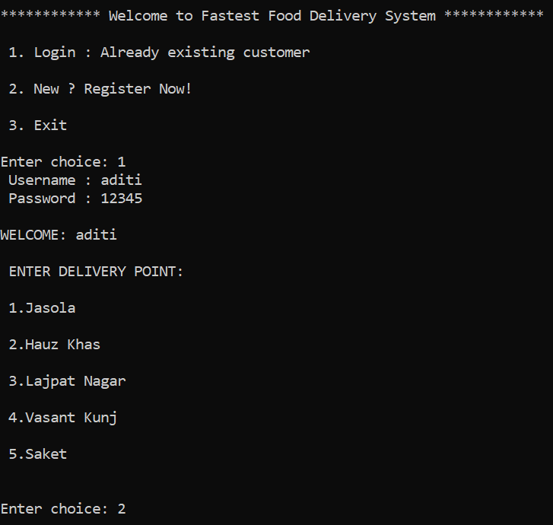
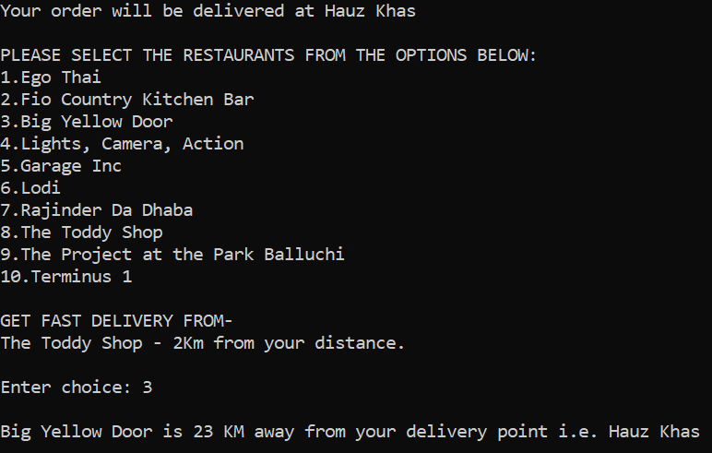
Program Output

Slide 27
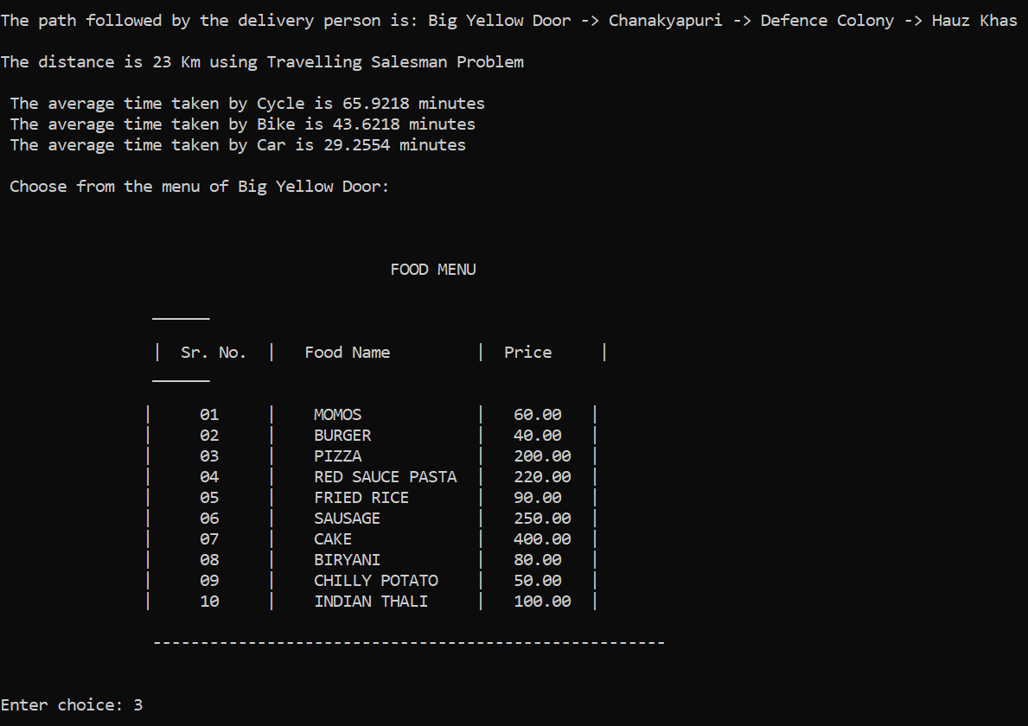
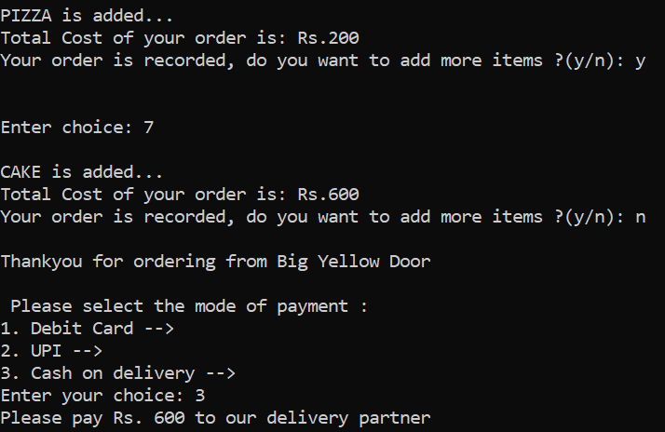
Program Output

Slide 28
Time complexity
Dijkstra Algorithm -> O(V^2) where V represents the edges for adjacency matrix.
Travelling Salesman Problem -> O(N²*2^N) the number of possible subsets can be at most N*2^N. Each subset can be solved in O(n) times
Time Calculator [Self-constructed] -> O(n*m) where n represents the size of paths covered and m represent the size of mapping.

Slide 29
Swot analysis
Strength:-
The program aims to find the shortest route between a restaurant and customer by comparing 2 different algorithms to ensure the best optimality.
It also suggests nearby restaurants to users from their delivery points.
The program is designed to calculate time based on several factors.

Slide 30
Swot analysis
Weakness:-
One practical drawback of the Dijkstra algorithm is it is a single source shortest path algorithm which consumes a lot of time increasing the time complexity.
In a situation where a customer resides at a place equally distant from a restaurant regardless of the path taken, optimality of the program will be at stake.

Slide 31
Swot analysis
Opportunity:-
There is an opportunity to allow the customer to pick-up their delivery from any location that intersects/lies in the route taken for delivery, in case of emergency.

Slide 32
Swot analysis
Threat:-
If a customer decides to order items from two separate restaurants in the same login phase, he will be denied for the same.

Slide 33
References
Let Us C++ by Yashwant Kanetkar
https://www.geeksforgeeks.org/dijkstras-shortest-path-algorithm-greedy-algo-7/
https://www.google.com/maps
https://www.interviewbit.com/blog/travelling-salesman-problem/

